Slide 1


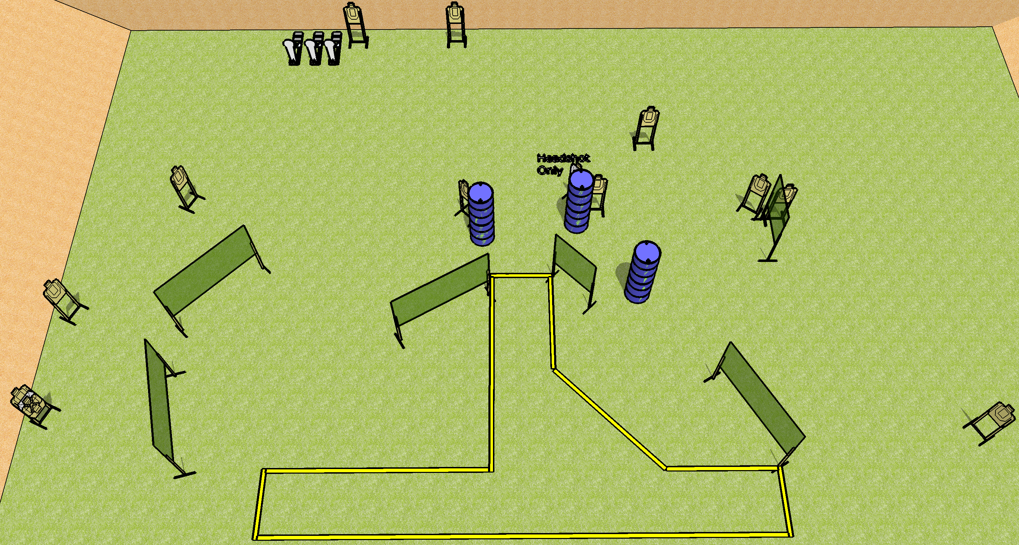
 | Dothan Gun Club – USPSA Match What Fools We Are Course Designer : Drew Coleman
Round Count 29 rounds 13 USPSA 3 Colt
Equipment List 12 wall feet 15 targets (13 + 2 NS) 3 medium fault lines
16’
8’
10’
8’
16’
36’

Slide 2
What Fools We Are
Written Stage Briefing
What Fools We Are is a 29 round, 145-point, Comstock course of fire. There are 13 USPSA targets and 3 steel. The best 2 hits on cardboard will score and steel must fall to score.
Handgun start position is anywhere inside the shooting area, wrists below belt. Handgun is loaded and holstered.
PCC start position is anywhere inside the shooting area, stock on belt. Loaded carbine is held with both hands, safety on.
On the audible start signal, engage targets as they become available from within the shooting area.

